Slide 1
Tic-Tac-Toe Web Game
This web-based adaptation brings the timeless fun of Tic-Tac-Toe right to your fingertips. With an intuitive interface and seamless gameplay, you can enjoy this classic game on any device with a web browser and internet connection.
Experience the thrill of Tic-Tac-Toe, the ultimate showdown between two players vying for victory in a 3x3 grid. Strategize, plot, and outsmart your opponent as you aim to get three of your symbols, be it X or O, in a row!
Presented by -
Yugal Y. Kosamshile

Slide 2
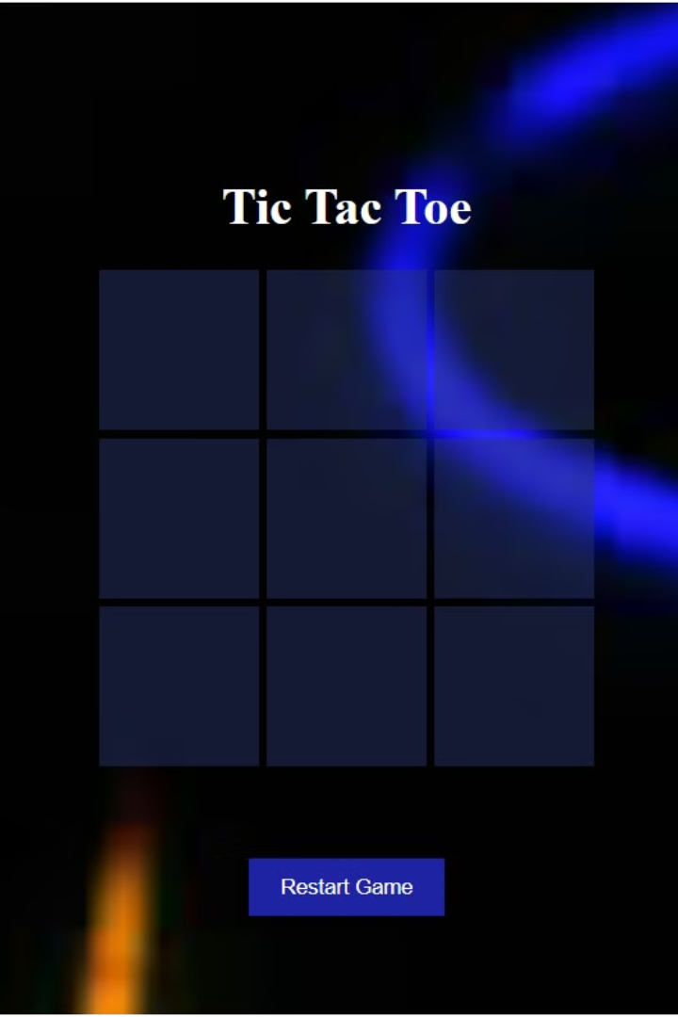
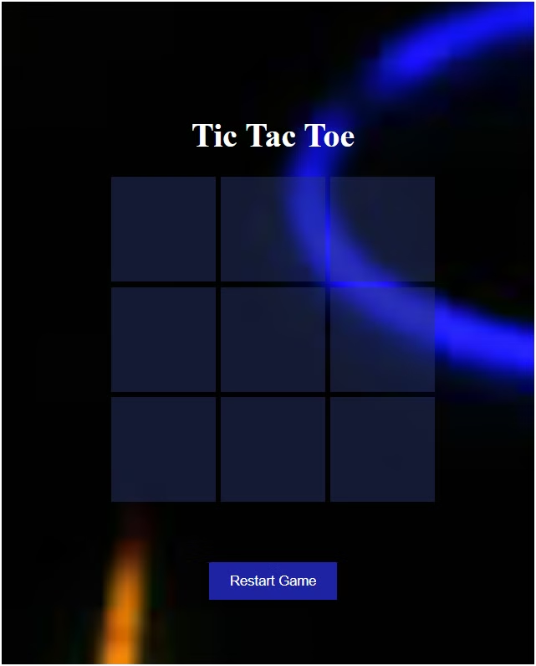
Components of the Game
HTML: The backbone of the game, defining the structure of the game board and interface elements.
CSS: Adds a touch of style and visual appeal to the game board, symbols, and other elements.
JS: Implements the game logic, including player turns, win conditions, and user interactions.

Slide 3
How It Works
Define Grid
1
The game board is a 3x3 grid where players take turns marking their symbols (usually X or O).
2
Player Turns
Players alternate placing their symbols on the grid, aiming to get three in a row horizontally, vertically, or diagonally.
Win Condition
3
The first player to get three of their symbols in a row wins the game. If the grid is filled without a winner, it's a tie.

Slide 4
Practical Uses
Educational Value
Entertainment Value
Social Interaction
Tic-Tac-Toe teaches logic, strategy, and spatial reasoning, making it a valuable learning tool.
The simple yet engaging gameplay appeals to players of all ages and skill levels.
Playing Tic-Tac-Toe promotes friendly competition and socialization with friends, family, or peers.

Slide 5
Advantages
1
Easy Accessibility
2
Entertainment and Stimulation
The web-based game is playable on any device with a web browser and internet connection.
The game provides a fun and challenging diversion for players seeking casual gameplay.
3
Coding Skill Enhancement
Developing a Tic-Tac-Toe game offers a practical project for learning and practicing web programming.
Disadvantages
1
Limited Complexity
2
Potential for repetitiveness:
The game may lack depth for players seeking more strategic or immersive gaming experiences.
The Gameplay may become predictable or monotonous after repeated play sessions.

Slide 6




Future Scope
AI Opponent
Multiplayer
UI Enhancements
Implementing an AI algorithm to provide a challenging opponent for solo players.
Allowing players to compete against each other in real-time matches over the internet.
Adding visual and auditory elements to enhance the overall gaming experience.

Slide 7

Conclusion
Tic-Tac-Toe is a timeless classic that has captivated players for generations. This web-based adaptation brings the simplicity and strategic depth of the game to your fingertips, offering accessibility, entertainment, and the potential for future enhancements.

